Slide 1

Lecture 6 Analysis of epidemic time-series part 3: quantifying trends in epidemic time series data consisting of signals from multiple pathogens, strains or variants
Lecturer: Oliver Eales

Slide 2
This lecture’s scope
In previous lectures we:
Introduced fundamental theory for analysing time series of infection incidence
Discussed biases in commonly available epidemic time series data
In this lecture we will:
Further investigate biases in epidemic time series from routinely collected surveillance data
Motivated by a case study of influenza surveillance
Discuss methods for improving how we report and analyse influenza surveillance data

Slide 3
Influenza surveillance

Slide 4
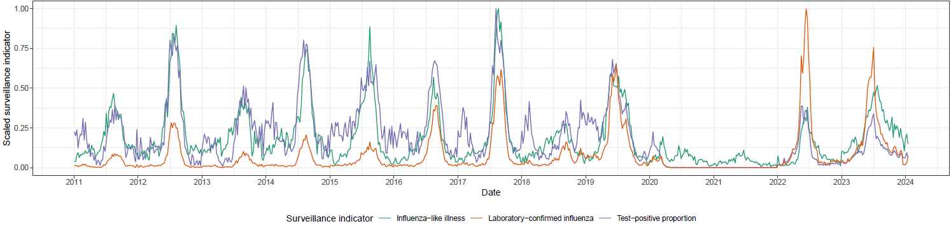
Background: why do we conduct influenza surveillance?
Monitoring the incidence of influenza infections is important for quantifying:
transmission dynamics (e.g., peak timing, peak magnitude, time of season onset)
clinical severity
Routine community surveillance typically reports three surveillance indicators:
Influenza-like illness (ILI)
Laboratory-confirmed influenza
The test-positive proportion
Often substantial differences between the trends of these indicators within and across influenza seasons

Slide 5
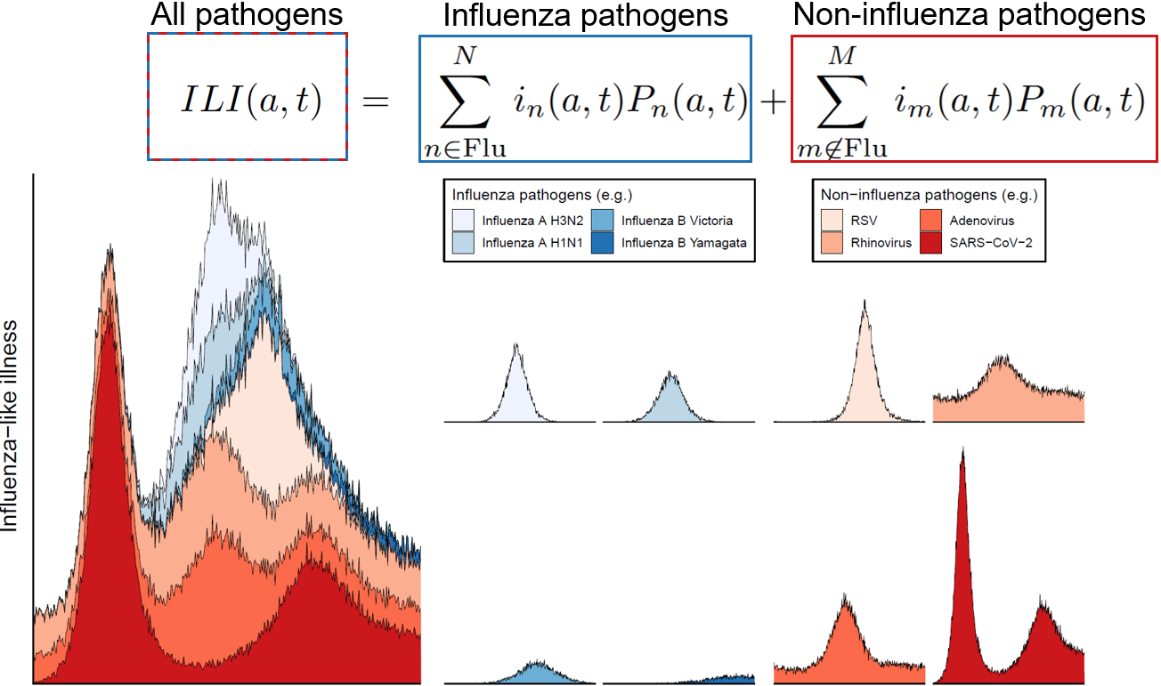
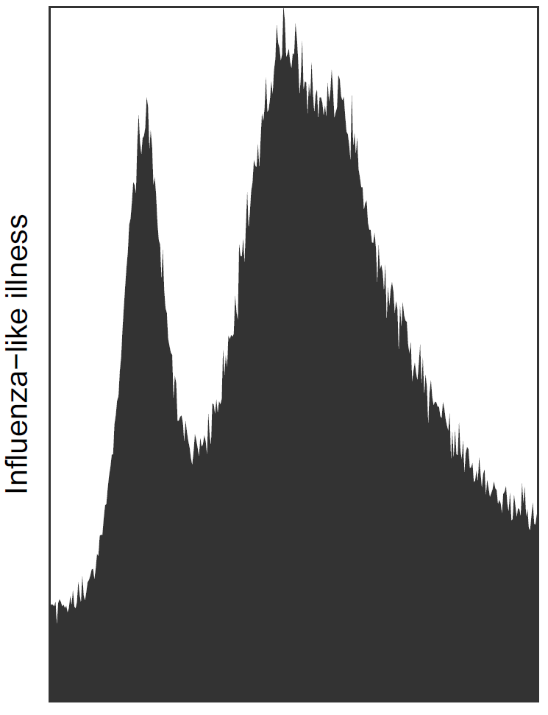
Surveillance indicators: Influenza-like illness (ILI)
ILI is the rate of influenza-like illness (usually) reported through sentinel healthcare sites per unit time
Influenza infections represent only a small fraction of ILI
The ILI time-series regularly used to quantify influenza dynamics mostly reflects the abundance of other pathogens (which also vary over time).
Eales et al. 2024. Influenza and Other Respiratory Viruses

Slide 6
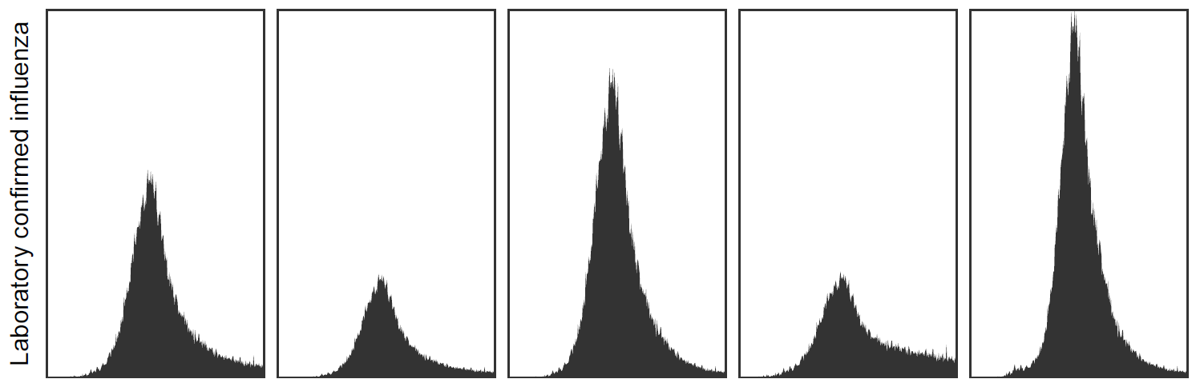
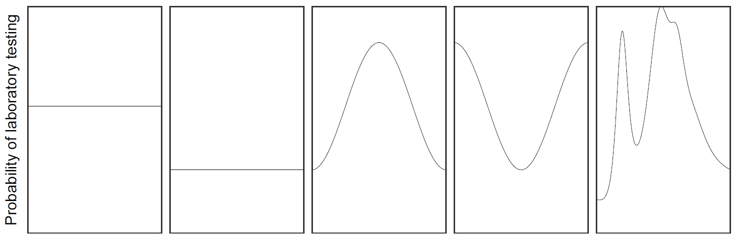
Surveillance indicators: Laboratory confirmed influenza (LCI)
Laboratory-confirmed influenza
The rate of laboratory-confirmed influenza infections per unit time
In some circumstances will not depend on other circulating pathogens
Influenced by the probability of laboratory testing being performed given presentation to healthcare with ILI
Probability of laboratory testing being performed can vary over time (both between seasons and within a single season)
Probability of laboratory testing

Slide 7
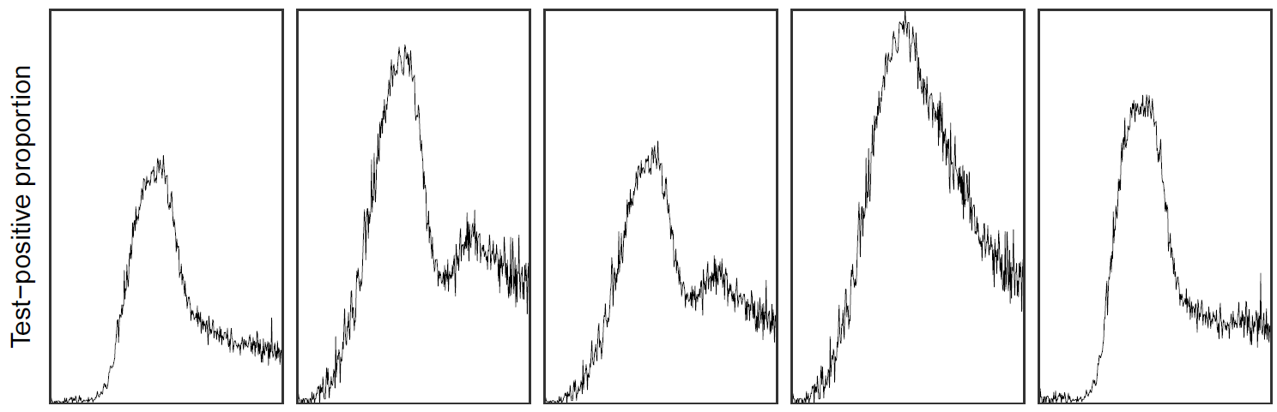
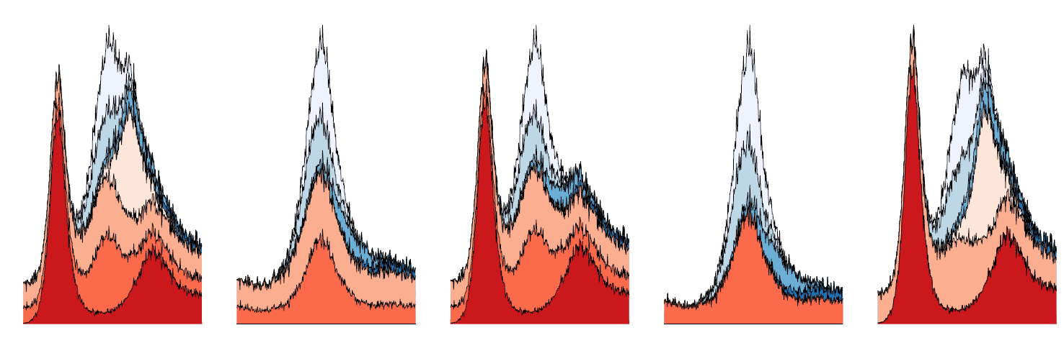
Surveillance indicators: the test-positive proportion (TPP)
The proportion of laboratory tests positive for influenza (‘percentage positive’)
Most difficult to interpret surveillance indicator used to represent influenza infection incidence.
Increases can reflect increases in influenza incidence or decreases in the incidence of other pathogens (e.g., SARS-CoV-2)
If ILI was only caused by influenza the test-positive proportion would be constant
Test-positive proportion
Influenza-like illness

Slide 8
Comparison of influenza surveillance indicators
Often substantial differences between the trends of these indicators within and across influenza seasons. For example:
Differences in relative peak magnitude
Differences in time of season ‘onset’
So which indicator would be best to report?

Slide 9
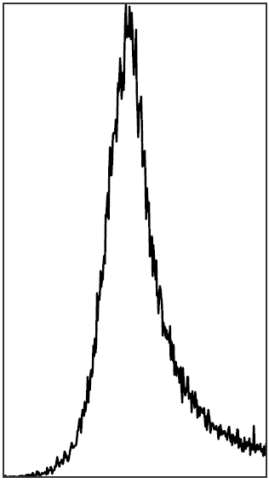
Report ILI+ as the primary surveillance indicator
All three surveillance indicators (ILI, LCI, TPP) are dependent on multiple unknown and unmeasured quantities
Other circulating ILI-causing pathogens
Laboratory testing rates
The data can be used to construct an indicator that more closely reflects trends in the underlying infection incidence
ILI+: the rate of influenza-like illness multiplied by the test-positive proportion
If laboratory testing also identifies other pathogens, then analogous surveillance indicators can be constructed for each pathogen
Test-positive proportion
ILI+
Influenza-like illness

Slide 10
Report ILI+ as the primary surveillance indicator
Influenza-like illness
All three surveillance indicators (ILI, LCI, TPP) are dependent on multiple unknown and unmeasured quantities
Other circulating ILI-causing pathogens
Laboratory testing rates
The data can be used to construct an indicator that more closely reflects trends in the underlying infection incidence
ILI+: the rate of influenza-like illness multiplied by the influenza test-positive proportion
If laboratory testing also identifies other pathogens, then analogous surveillance indicators can be constructed for each pathogen
Probability of laboratory testing
ILI+

Slide 11
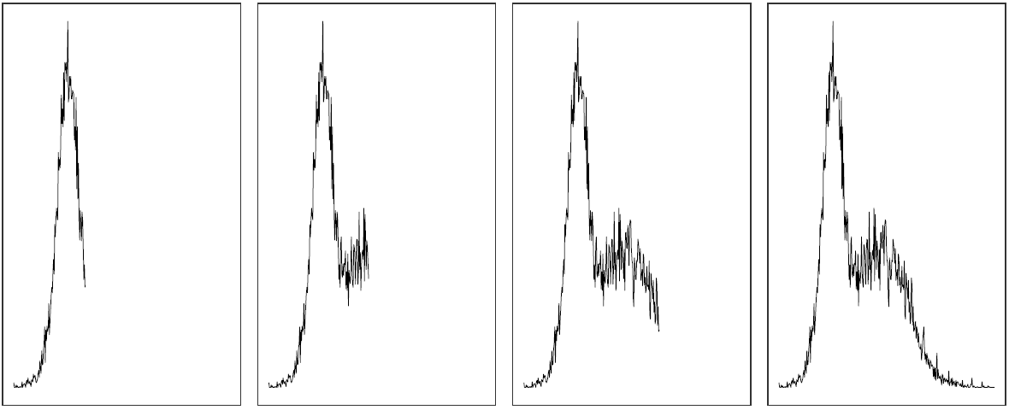
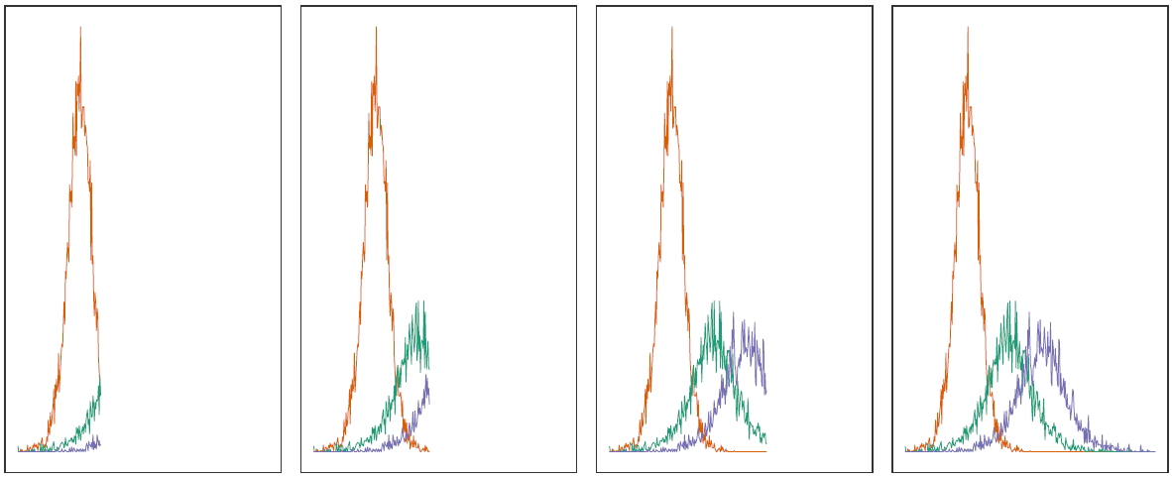
Stratify ILI+ by influenza type and subtype
ILI+
ILI+ can be stratified when there is subtype data available for a sample of laboratory-confirmed influenza
Influenza types/sub-types exhibit different epidemic dynamics
Making this distinction is important for predicting future epidemic activity
Subtype specific ILI+

Slide 12
Relevance to other types of pathogen surveillance

Slide 13
Syndromic surveillance
Syndromic surveillance indicators routinely collected to monitor trends are often a composite of multiple pathogens
For example, ILI and SARI contain contributions from multiple respiratory pathogens
Trends in the overall syndromic signal may not be the same as trends in the pathogen of interest
Composite signal
Pathogen of interest?

Slide 14
Confirmed cases (i.e. case-based surveillance)
Confirmed cases
The rate of confirmed cases per unit time
Laboratory-confirmed
RAT-confirmed
In some circumstances will not depend on other circulating pathogens
Influenced by the probability of testing/reporting. Depends on:
Test-seeking behaviour (for each test type)
Test-reporting behaviour
Test availability
Probability of testing

Slide 15
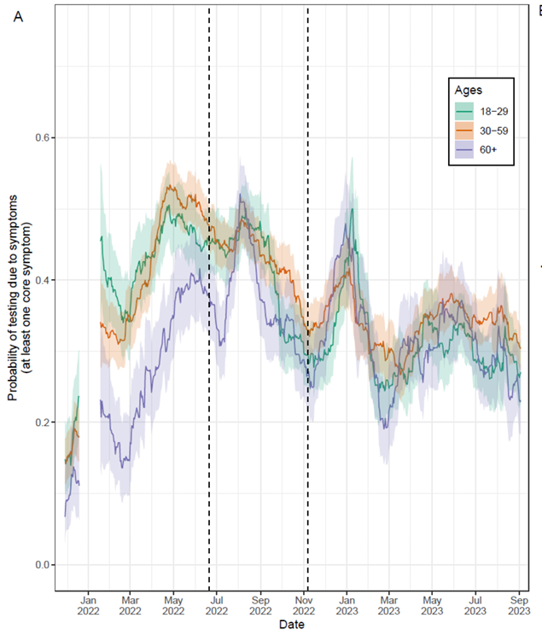
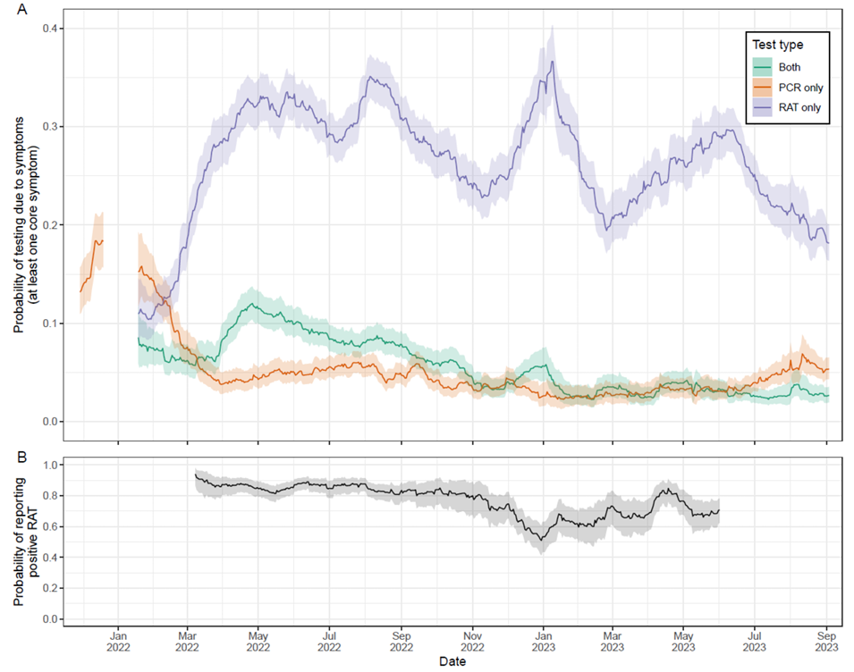
Confirmed cases (i.e. case-based surveillance)
The rate of confirmed cases per unit time is influenced by the probability of testing/reporting which can change over time
Probability of testing due to symptoms
Probability of testing due to symptoms
Probability of reporting positive RAT
Eales et al. 2025. Mathematics in Medical and Life Sciences

Slide 16
Test-positive proportion
The proportion of tests positive for a pathogen (‘percentage positive’)
Difficult to interpret surveillance indicator
Increases can reflect:
increases in the incidence of the pathogen of interest
decreases in the incidence of other pathogens
Test-positive proportion
Syndromic surveillance

Slide 17
Combining syndromic surveillance with test-positive proportion
Data can be used to construct a combined surveillance indicator that more closely reflects trends in the underlying infection incidence
The rate of syndromic cases multiplied by the test-positive proportion
If testing also identifies other pathogens, then analogous surveillance indicators can be constructed for each pathogen
Syndromic surveillance
Test positive proportion
Combined surveillance indicator

Slide 18
Stratify surveillance indicators by component pathogens
Many routine surveillance indicators are a composite of multiple pathogens:
Syndromic surveillance
SARS-CoV-2 variants
Influenza types/subtypes
Mpox clades
RSV groups
Each component pathogen may exhibit different epidemic dynamics
Supplementary data is often collected on the component pathogens contributing to the composite time series:
SARS-CoV-2 variants sequenced
Influenza typing/subtyping
Multiplex testing for respiratory pathogens
Composite time series
Component pathogens

Slide 19
How are component pathogen data typically presented?

Slide 20
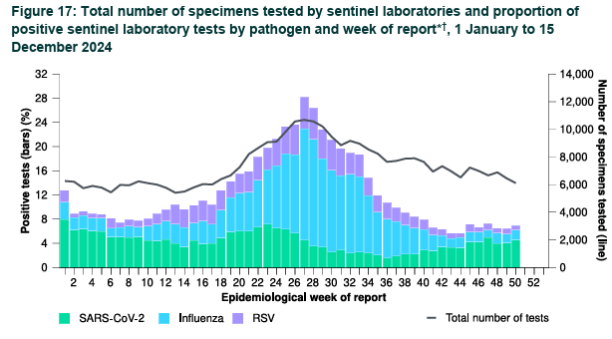
How are multi-component data typically presented?
Is the positive proportion of RSV increasing or decreasing?
Are cases of SARS-CoV-2 increasing or decreasing?
Australian Respiratory Surveillance Report
Report 17, 2024
Section 5: Genomic surveillance and virology

Slide 21
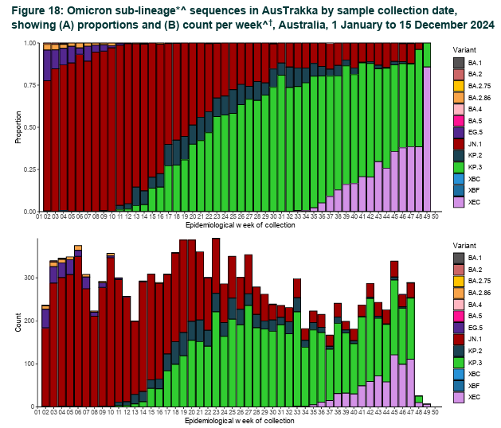
How is data currently presented?
Which Omicron sub-lineage will be dominant in 2 months time?
KP.2
KP.3
JN.1
What was the impact of the emergence of XEC on infection levels?
Australian Respiratory Surveillance Report
Report 17, 2024
Section 5: Genomic surveillance and virology

Slide 22
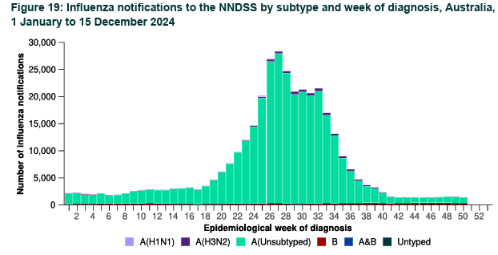
How is data currently presented?
Which influenza subtype dominated during the 2024 influenza season?
Is influenza A H1N1 increasing or decreasing?
Australian Respiratory Surveillance Report
Report 17, 2024
Section 5: Genomic surveillance and virology

Slide 23
Statistical methods

Slide 24
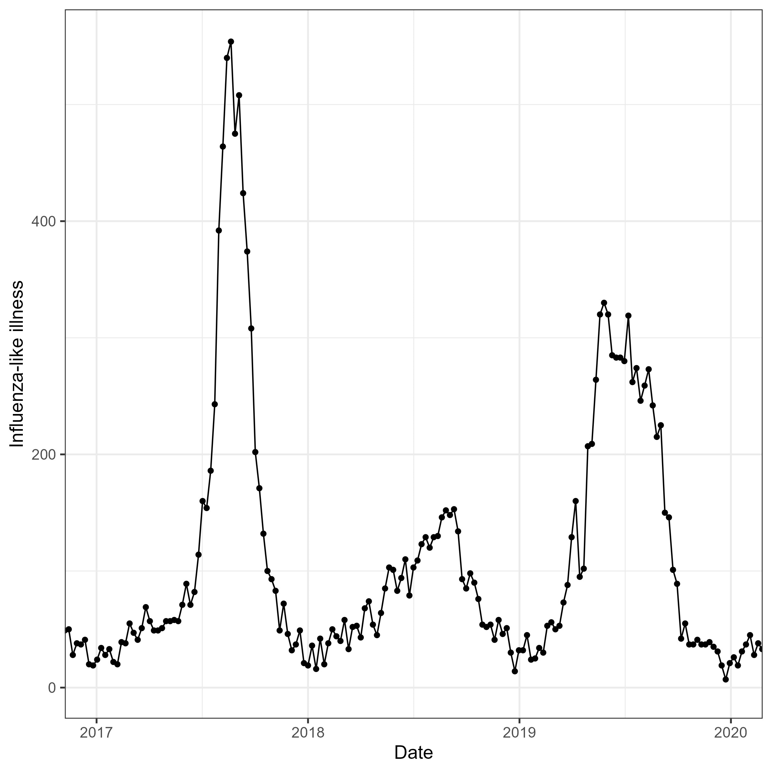
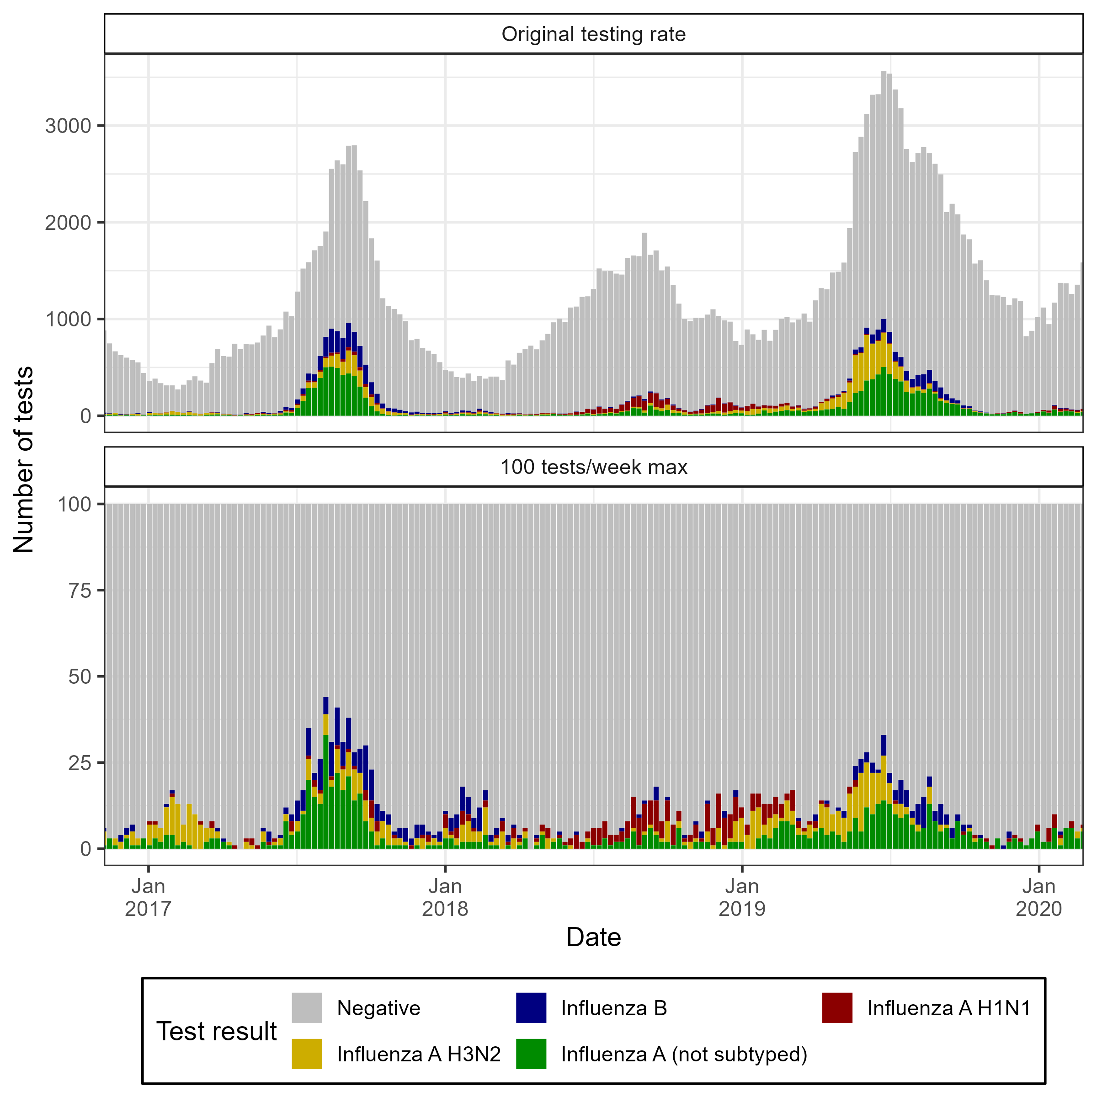
What does ILI+ look like in practice?

Slide 25
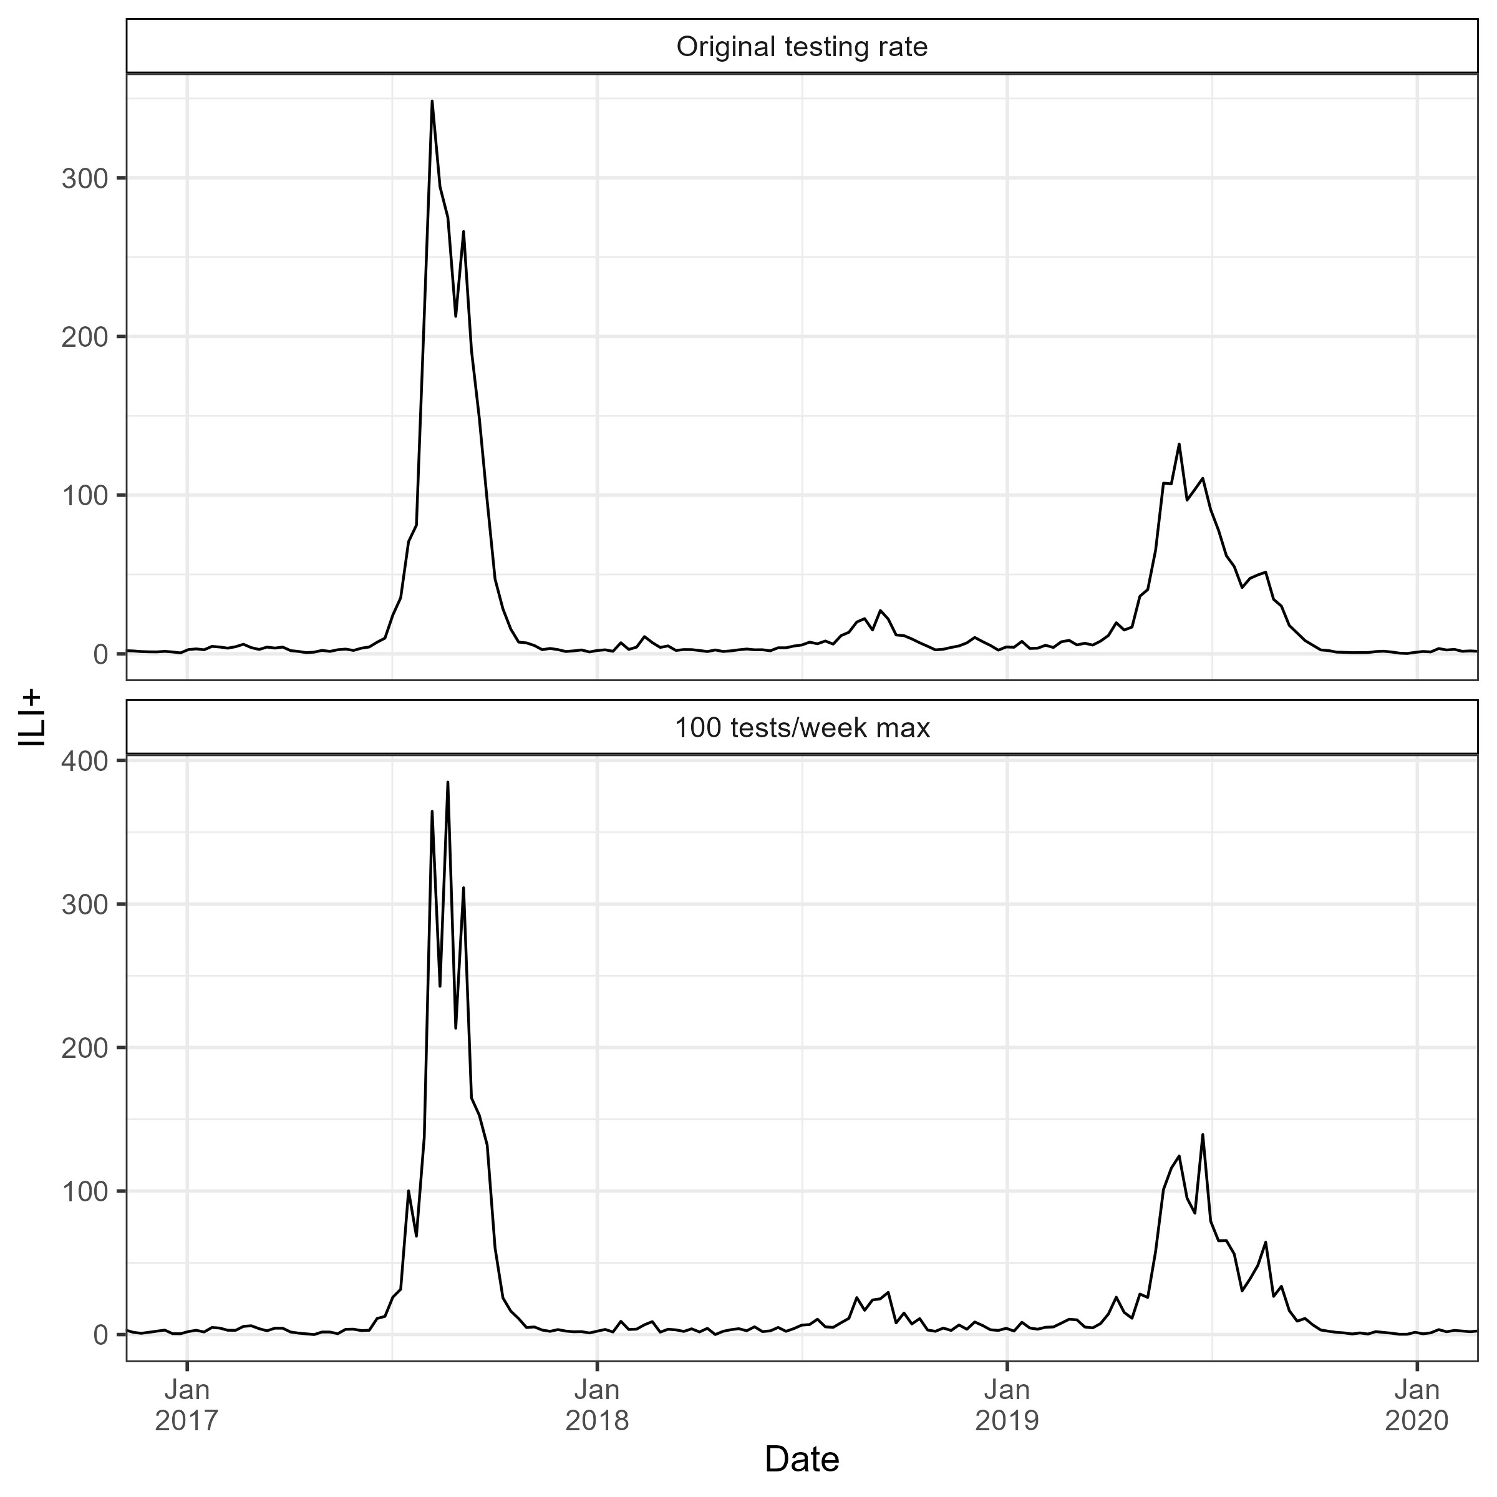
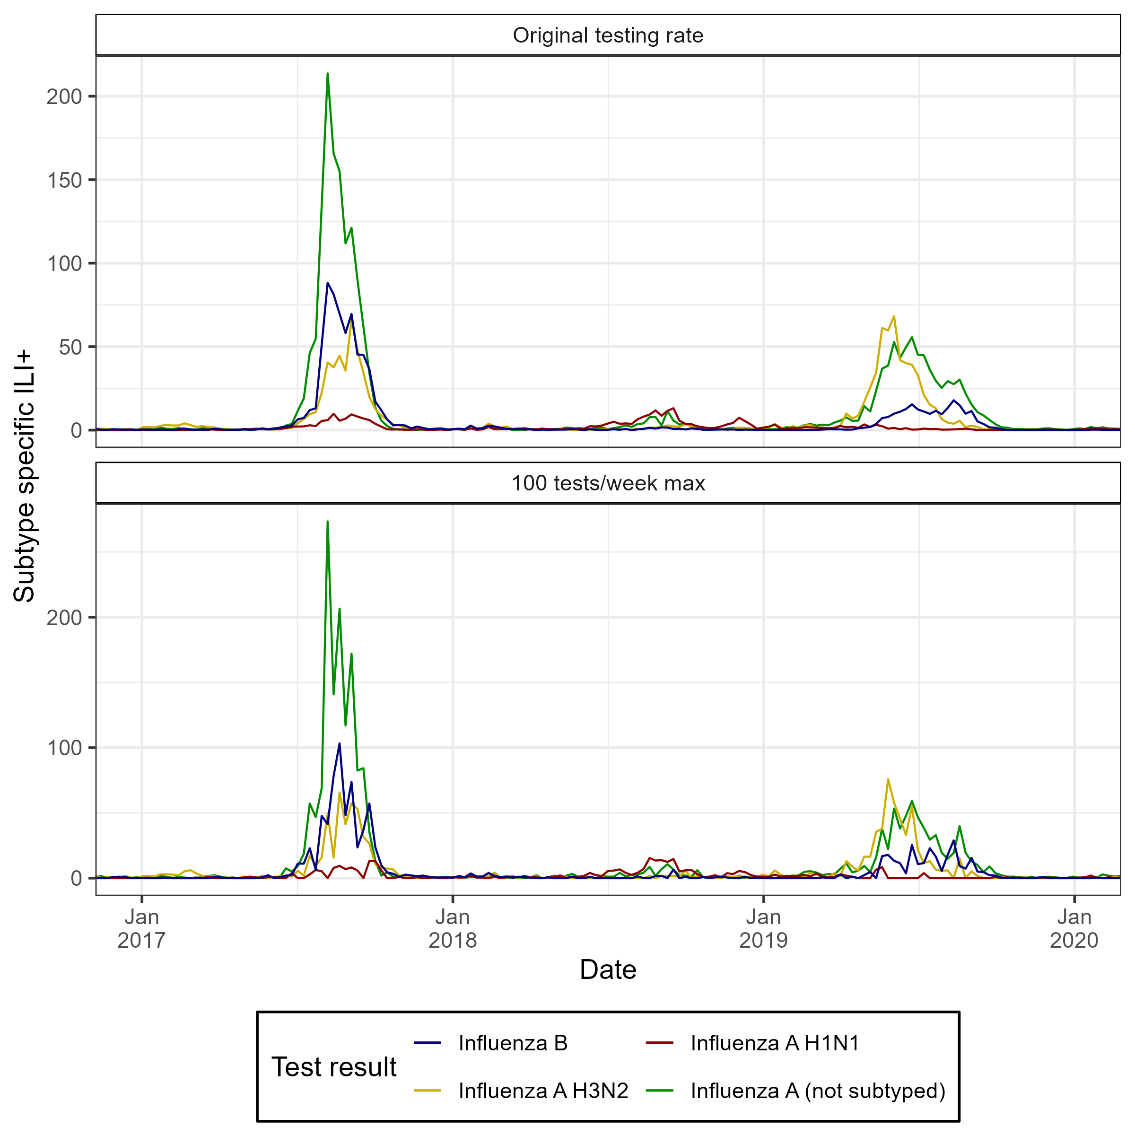
What does ILI+ look like in practice?
Noisy and would be even noisier for daily data.

Slide 26
Statistical models can be used to account for noise
Statistical model exists for simultaneously estimating epidemic dynamics of multiple pathogens using routinely collected surveillance data
The model takes as input:
A time series of count data (i.e. the composite time series)
A time series of count data describing test results (i.e. the component time series).
Implementation of model in the R package ‘EpiStrainDynamics’

Slide 27
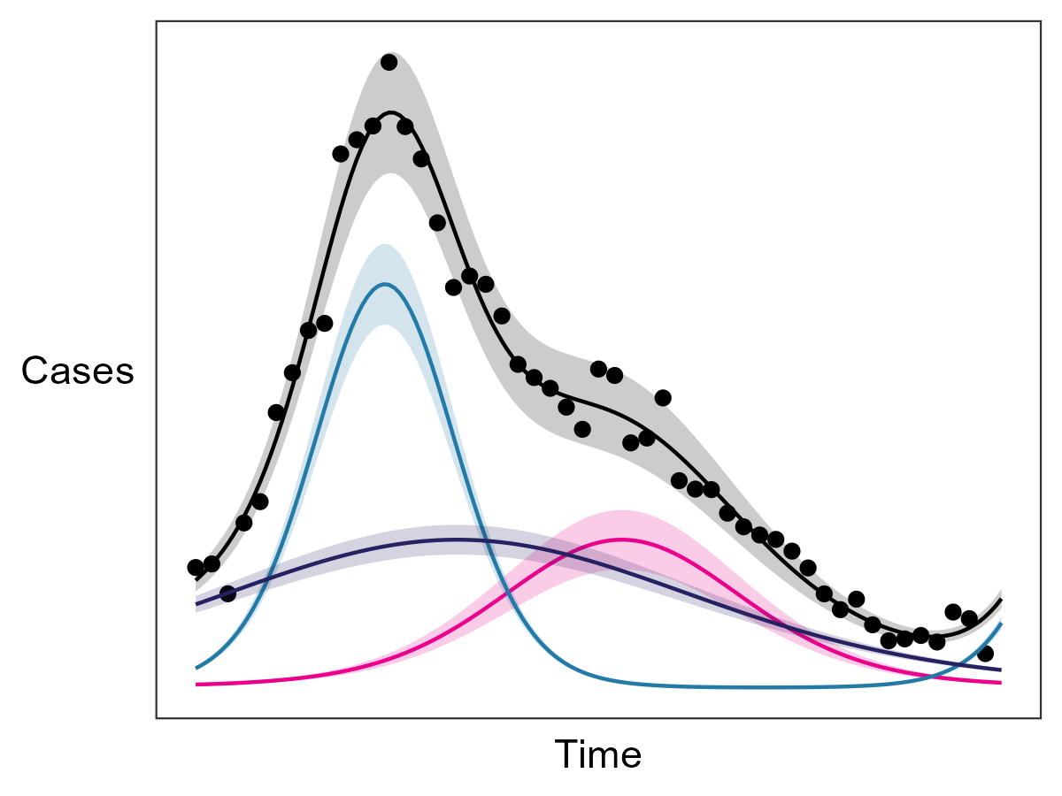
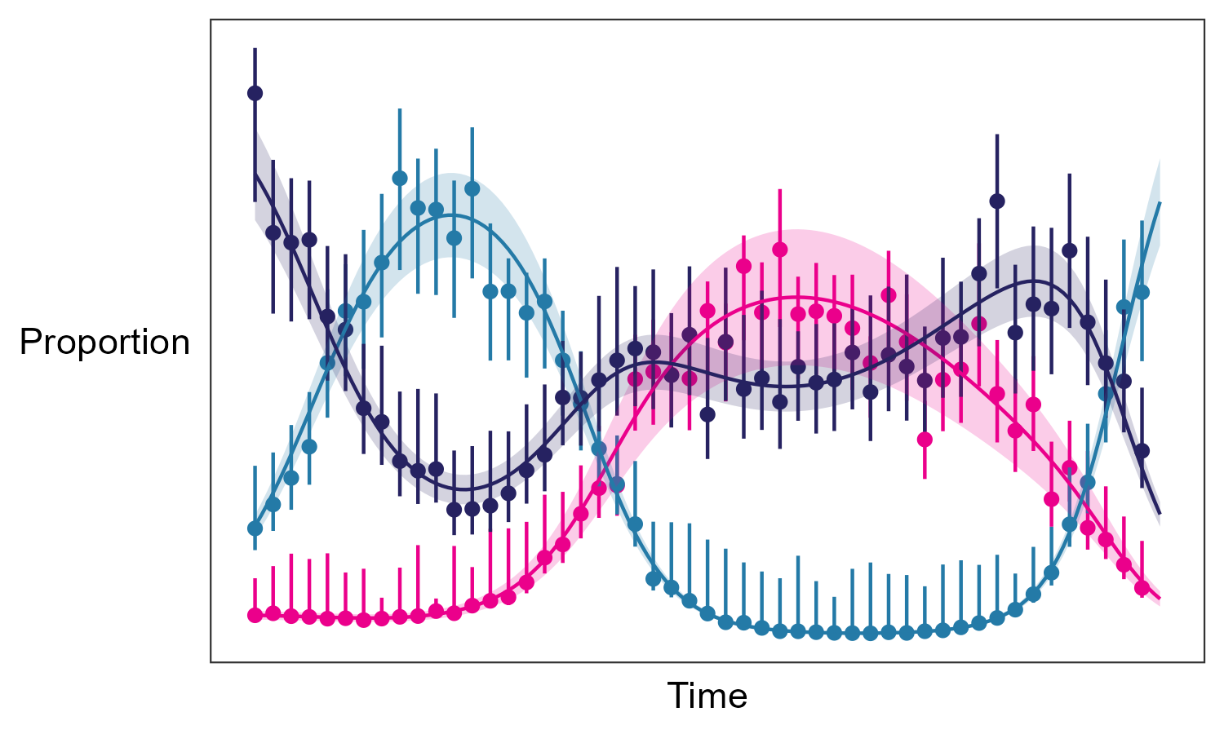
Statistical models can be used to account for noise
Cases of each pathogen modelled as smooth functions
Simultaneously fits:
Sum of modelled cases (for each pathogen) to composite time series
Relative proportion of modelled cases (for each pathogen) to component time-series
For full methodological details please refer to Eales et al. 2025 American Journal of Epidemiology

Slide 28
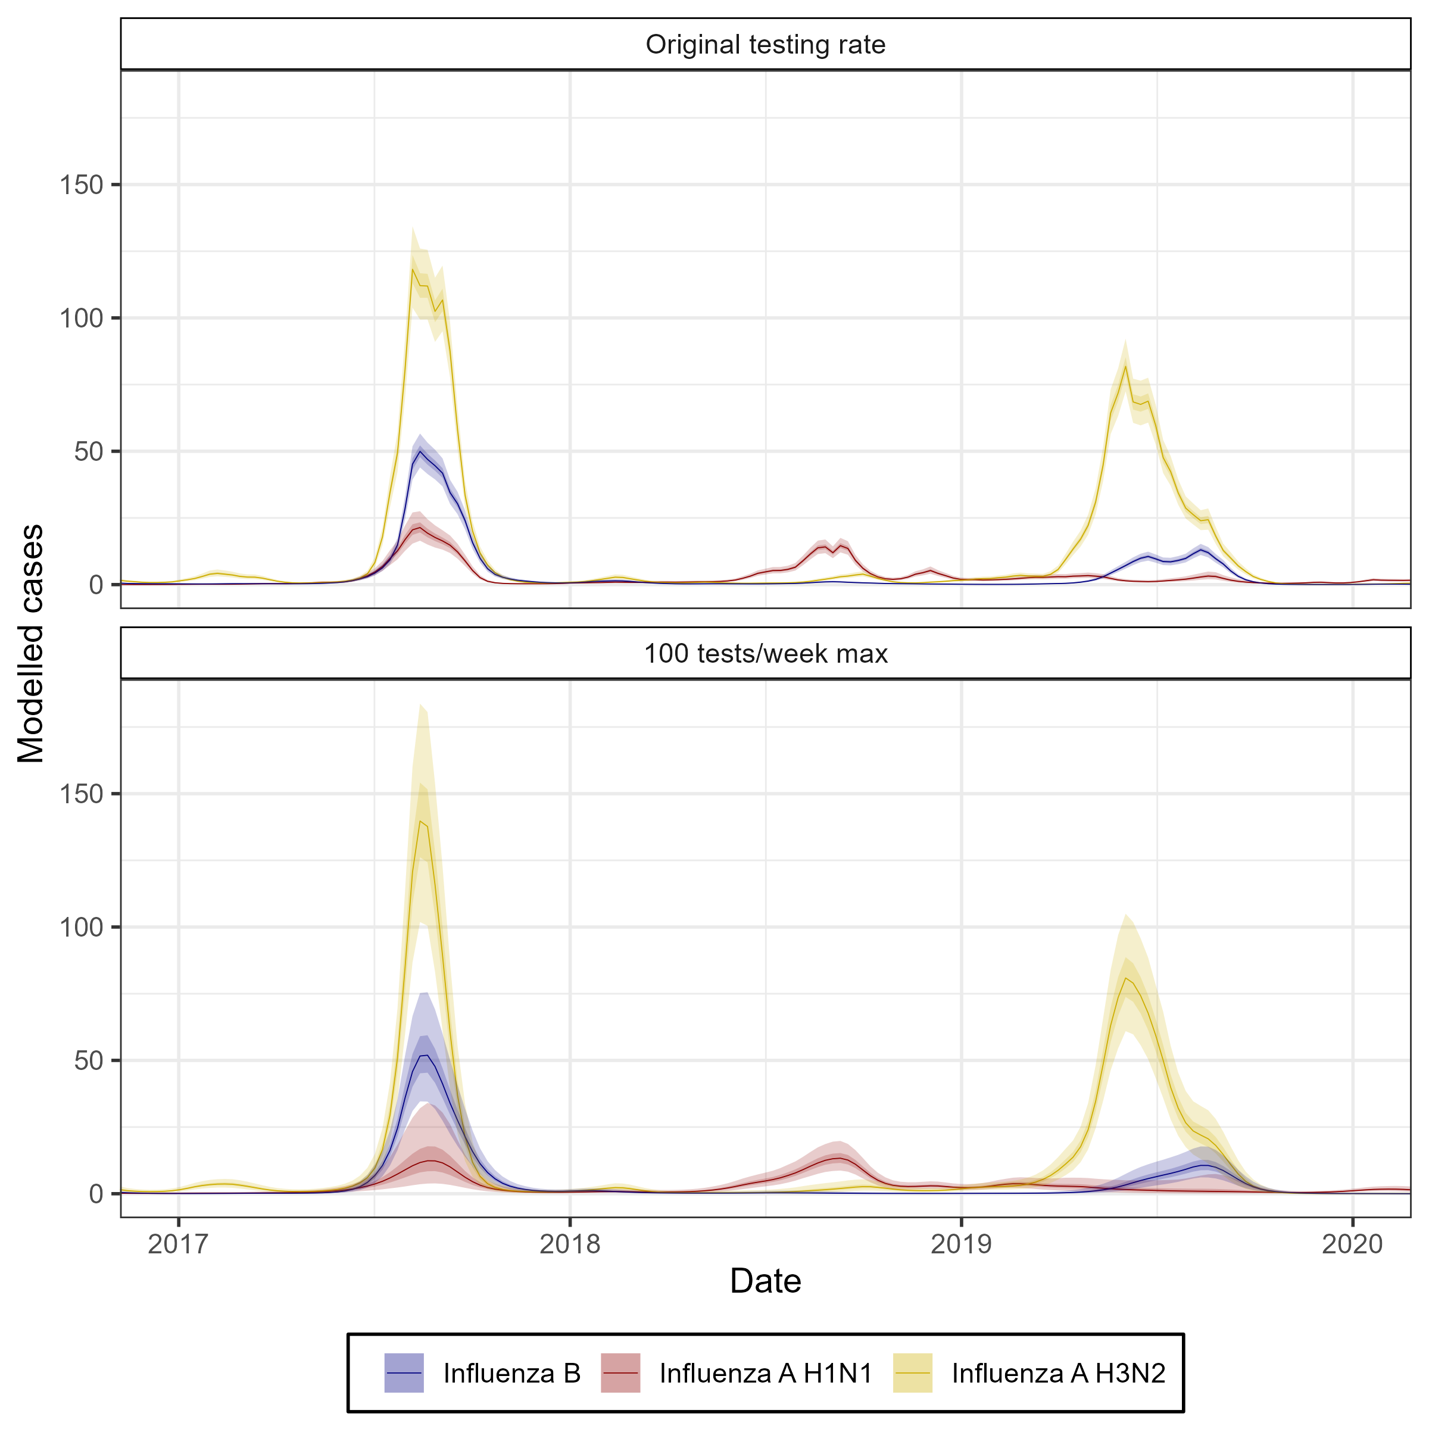
Statistical models can be used to account for noise
Raw time series
Modelled time series

Slide 29
Case studies

Slide 30
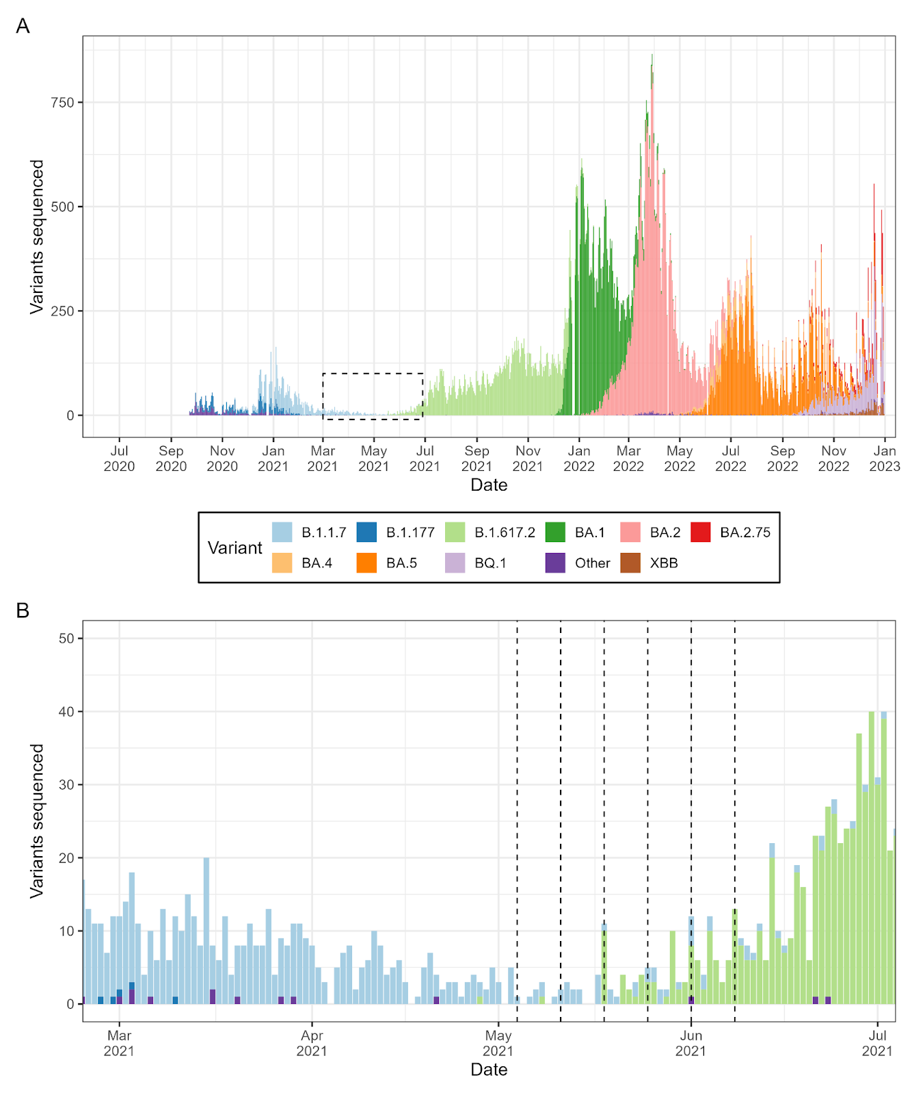
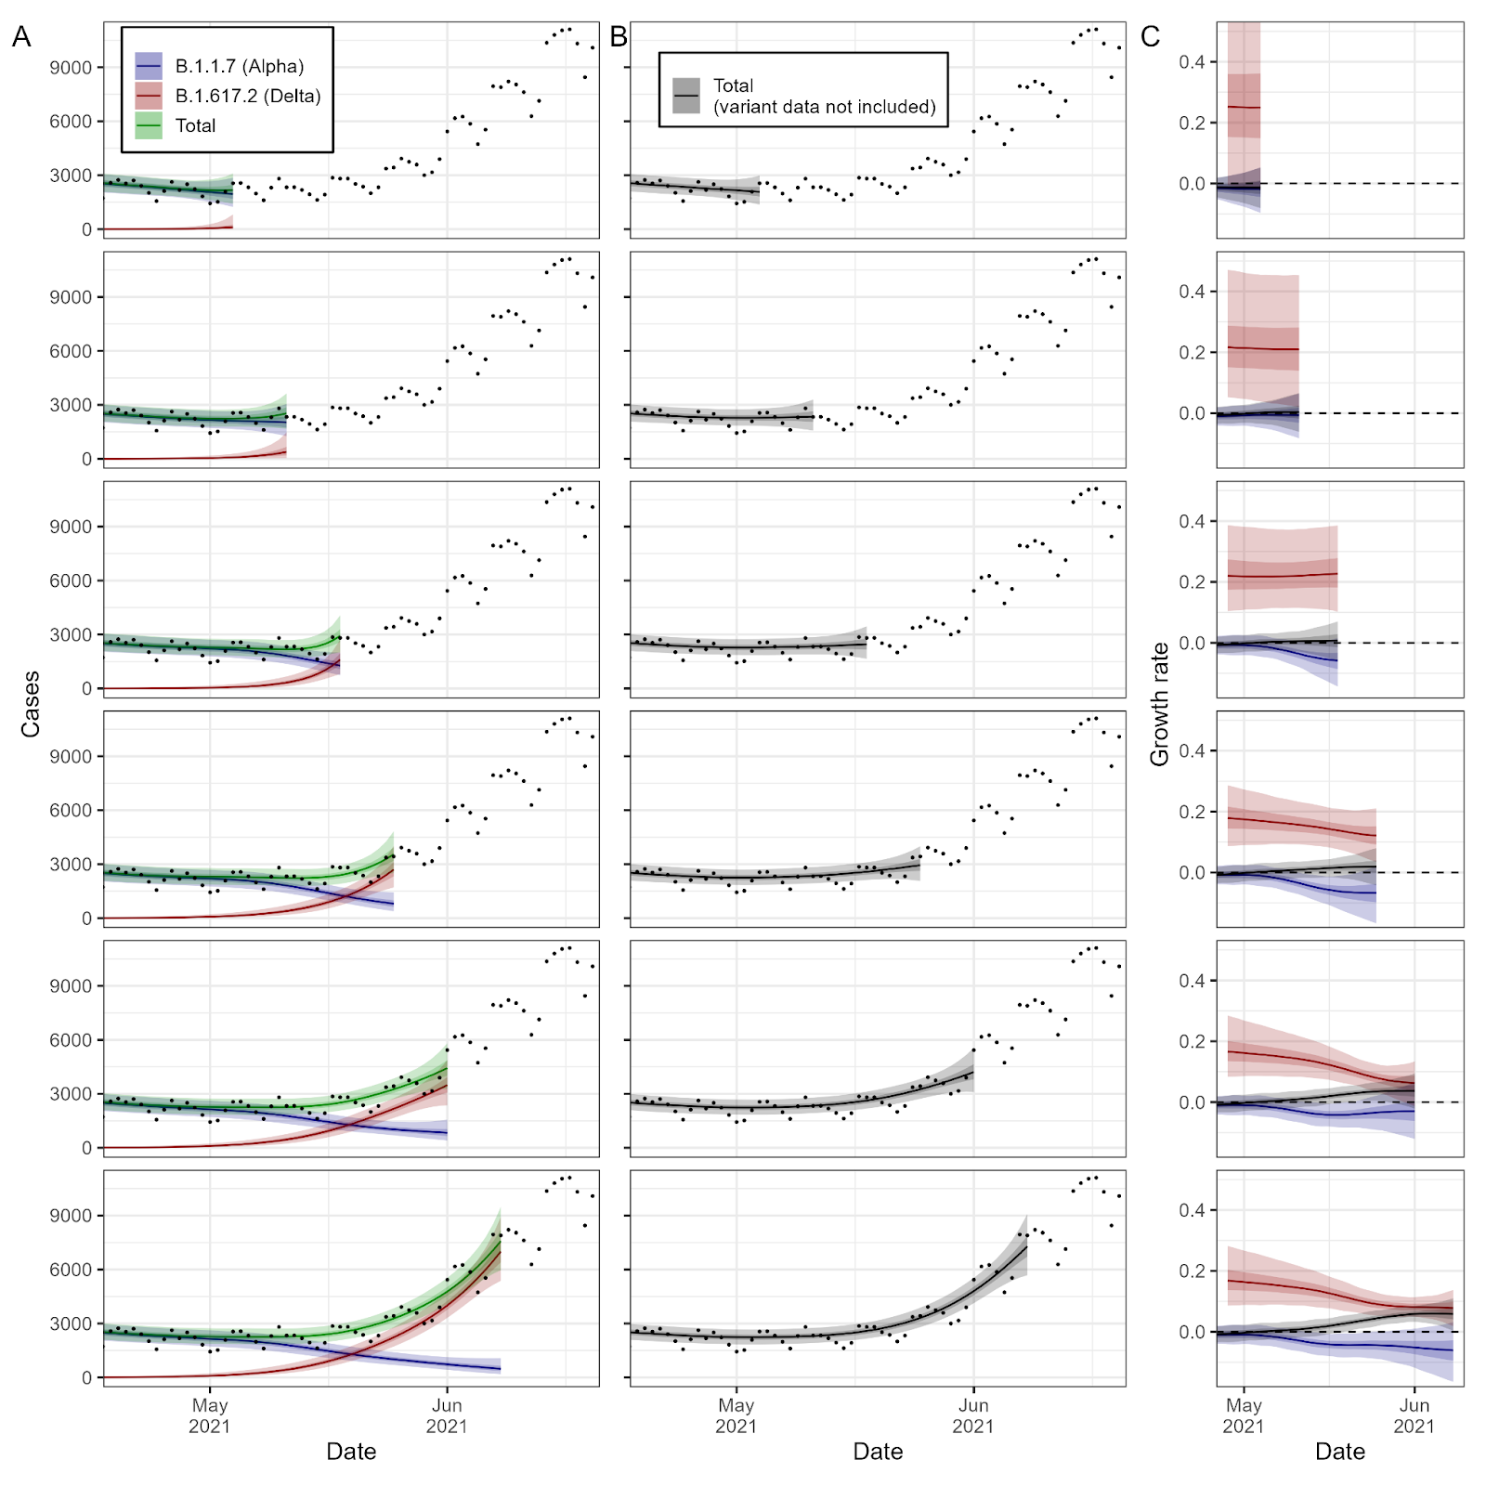
Case study: Delta variant emergence in the United Kingdom
Useful for real-time analysis
Can identify components with higher growth rates
Even when composite time series is not increasing
Not including variant data in analysis can delay identification of growth signal
First delta detection
Cases
Growth rate
Eales et al. 2025 American Journal of Epidemiology

Slide 31
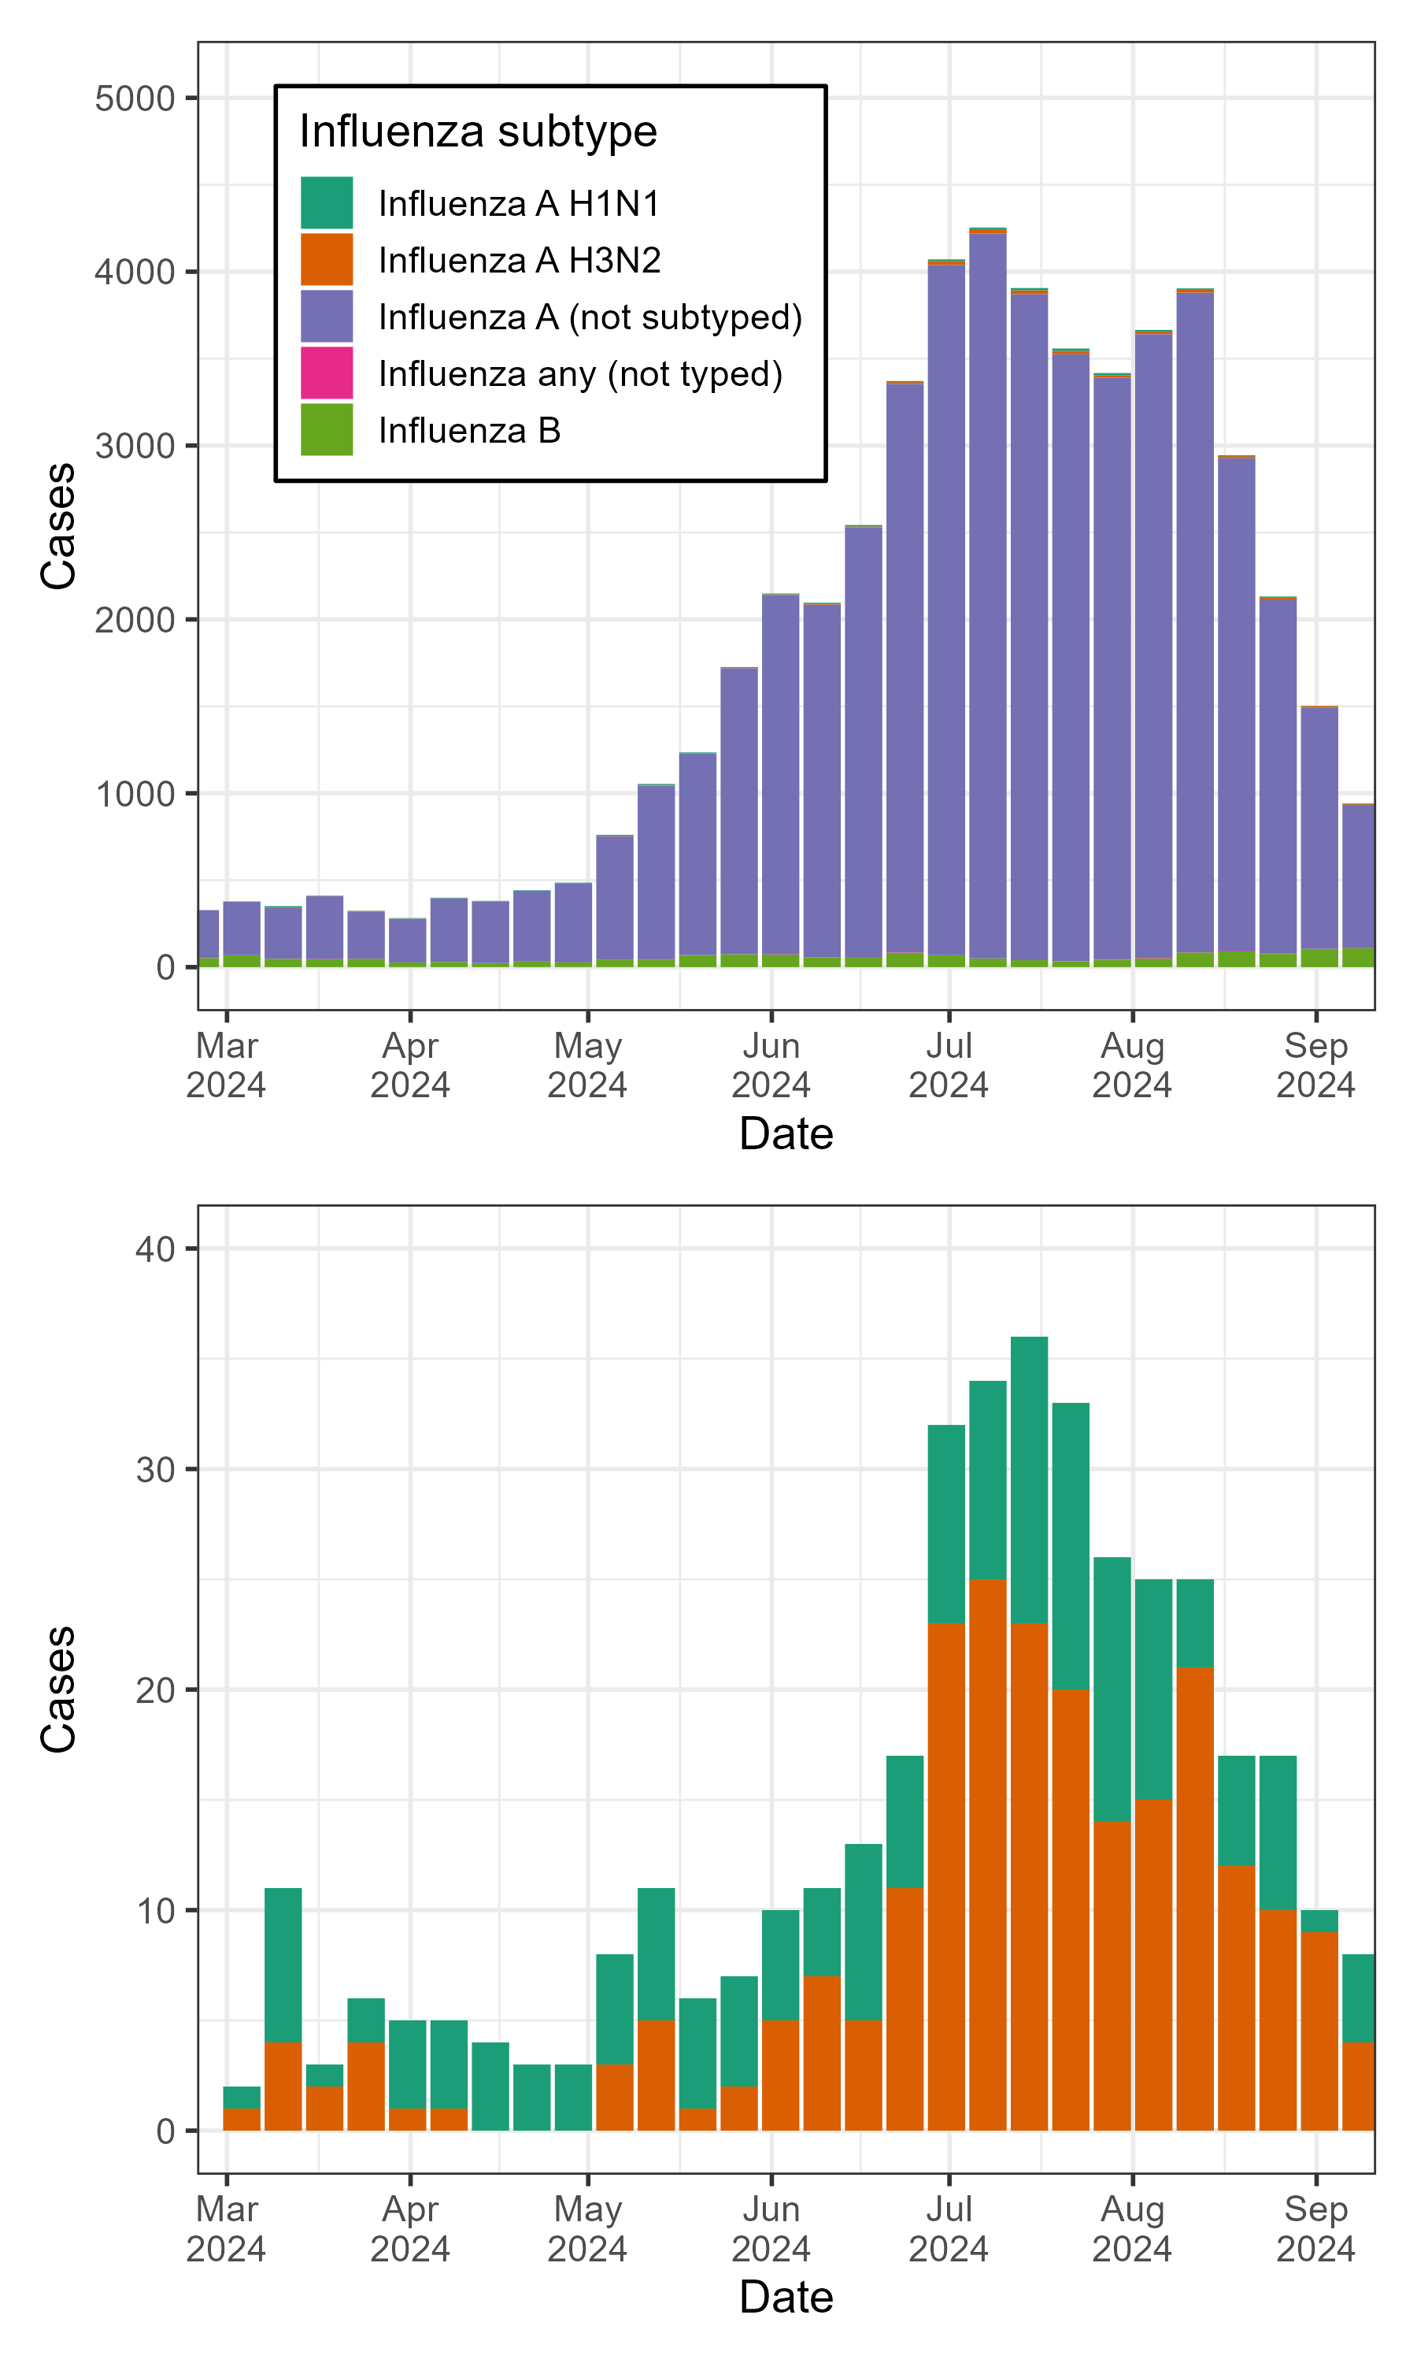
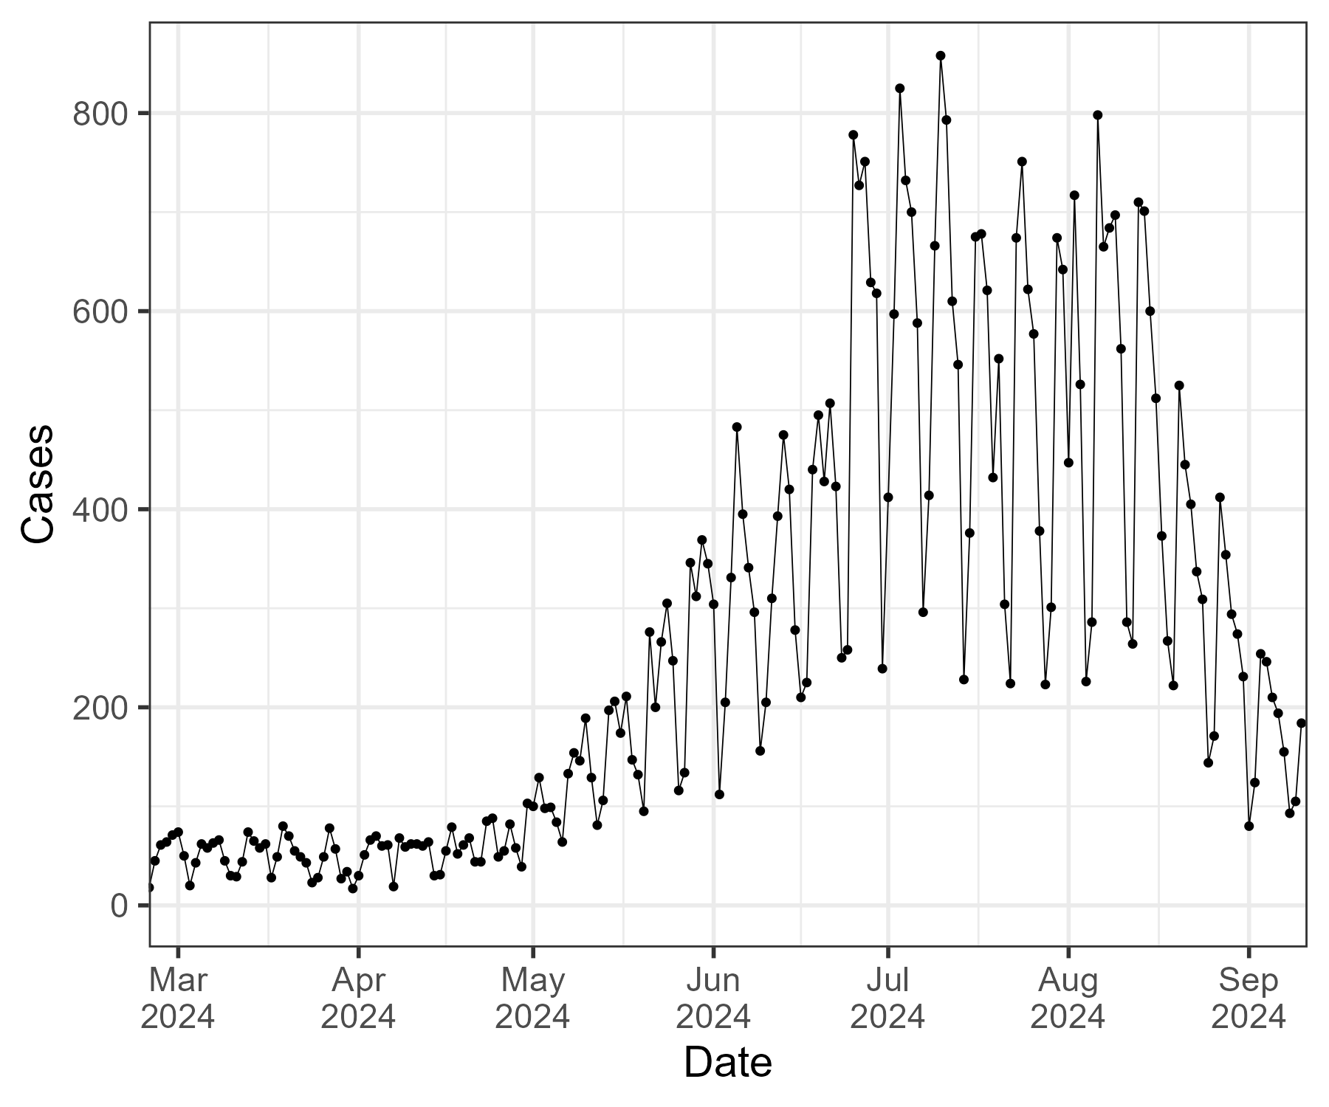
Case study: Real-time analysis of influenza subtypes in Victoria
During winter 2024 we performed analysis for laboratory confirmed influenza cases
Daily number of laboratory confirmed cases
Strong day-of-the-week effects
Results of typing/subtyping
Subtyping performed for ~1% of samples
Eales et al. 2025. Communicable Diseases Intelligence

Slide 32
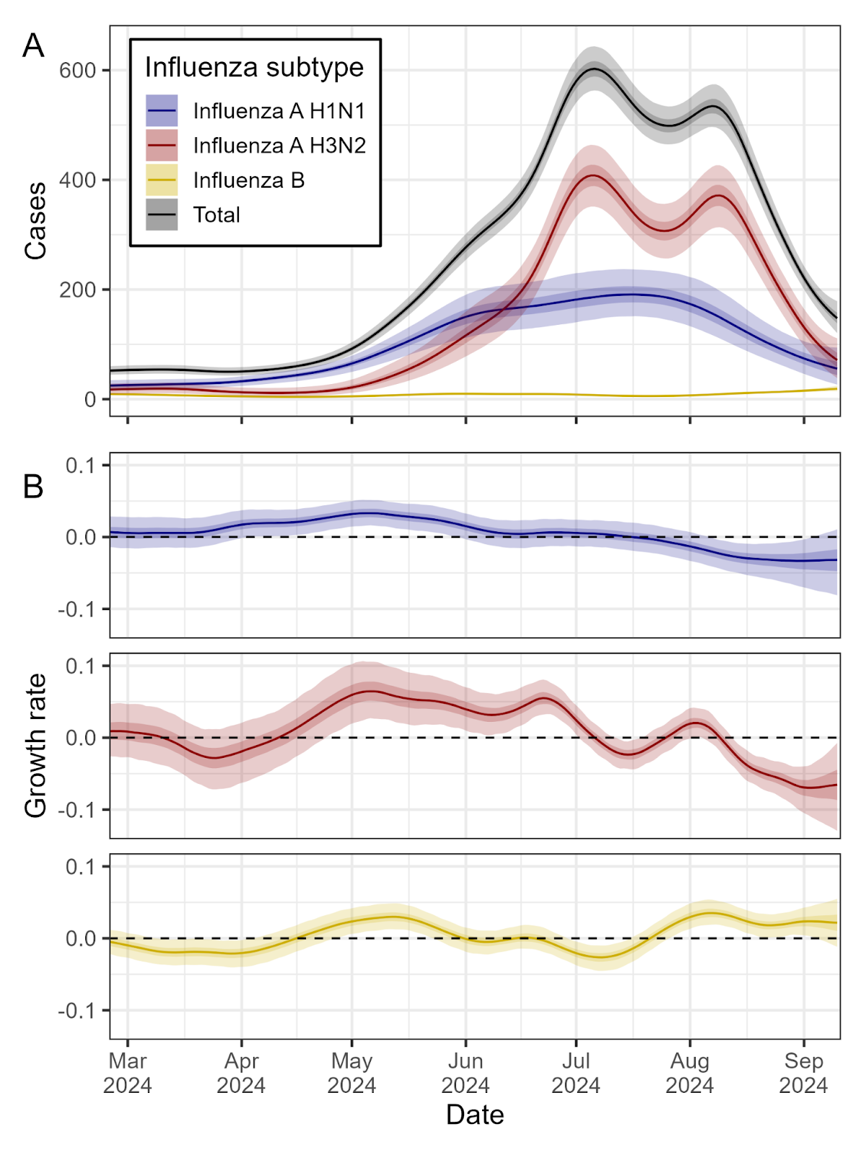
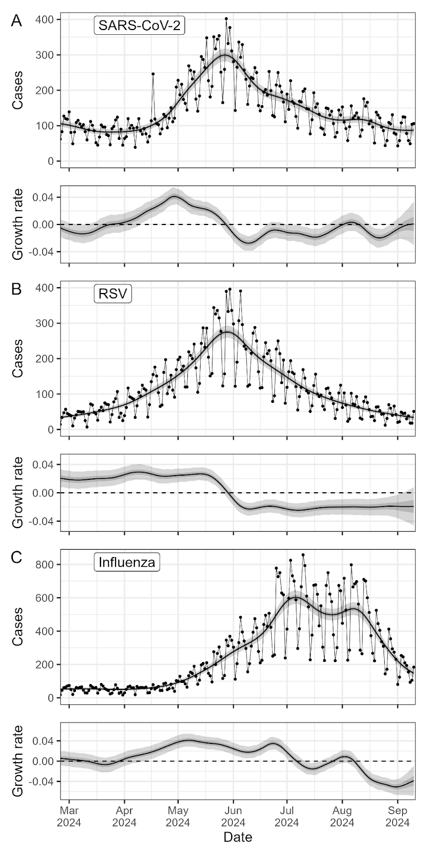
Case study: Real-time analysis of influenza subtypes in Victoria
Estimate smoothed trends in the:
Total number of influenza cases
Subtype specific influenza cases
Time-varying growth rates for each subtype
H3N2 dominated the later part of the season with consistently higher growth rate from early-May
Eales et al. 2025.

Slide 33
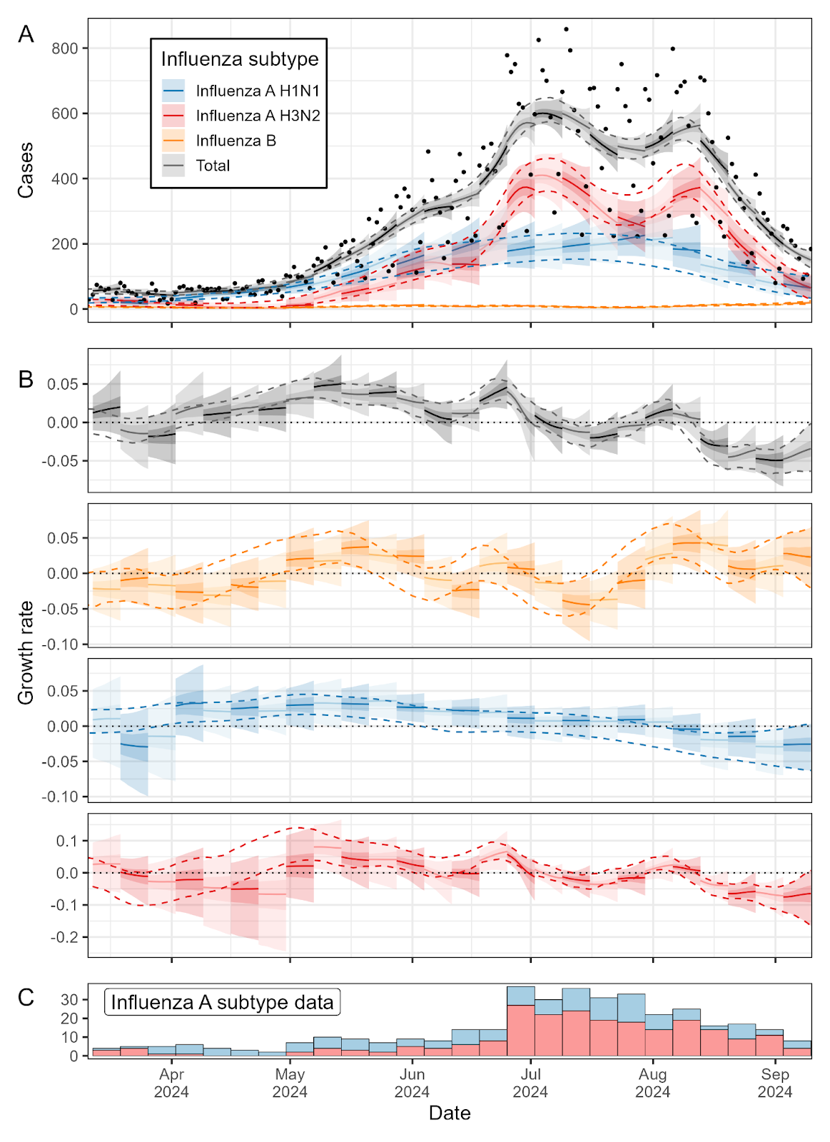
Case study: Real-time analysis of influenza subtypes in Victoria
Real-time subtype specific estimates were broadly consistent with final end-of-season estimates
Compare:
Solid lines and shaded regions (real-time estimates)
Dashed lines (95% CrI end-of-season estimates)
Some disagreement during April 2024
A period when modelled cases were very low for H3N2 and very little subtyping was occurring
Eales et al. 2025.

Slide 34
Summary
We have discussed some of the biases present in epidemic time series that are routinely measured and reported
For a more extensive description see the further reading for this lecture
We have demonstrated that epidemic time series data are often composed of multiple signals from different pathogens. For example:
SARS-CoV-2 variants
Other respiratory pathogens contributing to ILI
Mpox clades
Dengue serotypes
RSV groups
Statistical models exist that can infer trends in multiple pathogens from routine surveillance data
R package in development (EpiStrainDynamics)

Slide 35
References
Eales O, McCaw JM, Shearer FM. Biases in routine influenza surveillance indicators used to monitor infection incidence and recommendations for improvement. Influenza Other Respi Viruses. 2024;18: e70050.
Eales O, McCaw JM, Shearer FM. Challenges in the case-based surveillance of infectious diseases. R Soc Open Sci. 2024;11: 240202.
Eales O, Windecker SM, McCaw JM, Shearer FM. Inferring temporal trends of multiple pathogens, variants, subtypes or serotypes from routine surveillance data. American Journal of Epidemiology. 2025
Eales O, et al. Temporal analysis of respiratory virus epidemics in Victoria over winter 2024. Communicable Diseases Intelligence. 2025 [in press]

